Slide 1
Unit Title: Front-end Web Development
Topic 5: CSS Flexbox and Grid Layout
Notes:
NCC Education - Title Master

Slide 2
Scope and Coverage
This topic will cover:
CSS Grid
CSS Grid layout
CSS Flexbox Layout
Notes:
NCC Education - Slide Master

Slide 3
Learning Outcomes
By the end of this topic students will be able to:
Create and design responsive website using Flexbox and Grid Layout
Use CSS3 layout model: Flexbox for responsive and mobile-friendly design
Explain the difference between CSS Grid Layout and CSS Flexbox Layout

Slide 4
Unit Roadmap
Week | Topic | Week | Topic
1 | Overview of Web Application Architecture | 7 | JavaScript - II
2 | Introduction to HTML5 | 8 | jQuery
3 | Introduction to CSS | 9 | Responsive CSS Framework: Bootstrap I
4 | HTML and CSS | 10 | Responsive CSS Framework: Bootstrap II
5 | CSS Flexbox and Grid Layout | 11 | Code Review, Testing and Collaboration
6 | JavaScript - I | 12 | Unit Summary

Slide 5
Css grid layout

Slide 6
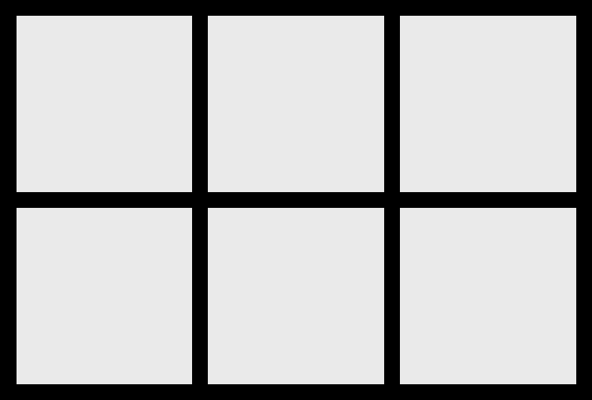
What is CSS GRID?
A concept that defines the layout and responsiveness of websites.
CSS Grid is a 2-dimensional layout system that can handle both columns and rows.
Grid items can be positioned into the grid cell, spanning one or more cell, and even layered over one another.

Slide 7

GRID Container
The grid container is the parent of all grid items.
It is declared with the display: grid; rule.

Slide 8
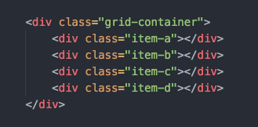
GRID Item
The items that are direct children of the grid container.
These are the elements that will be placed on the grid.

Slide 9
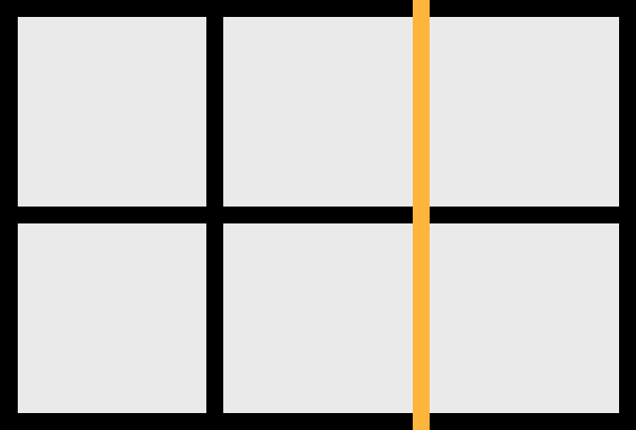
GRID Lines
The lines that divide the columns and rows of the grid.
These are numbered starting with 1.
Grid lines can be referenced using positive numbers from the start (left/top) or negative numbers from the end (right/bottom).

Slide 10
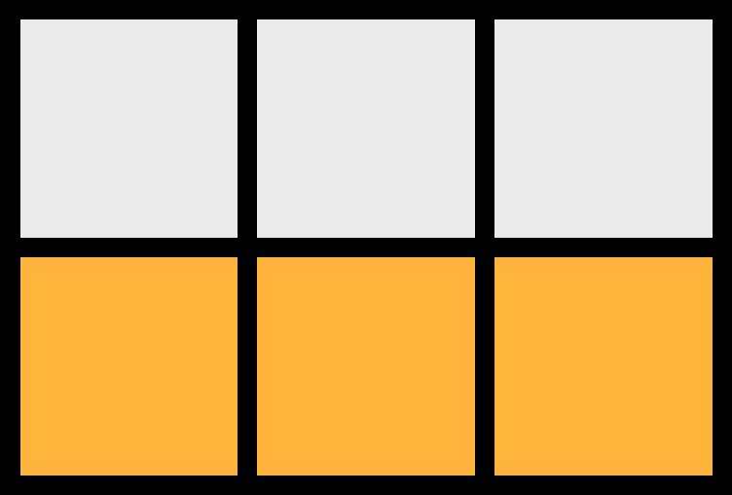
GRID TRACK
The space between 2 adjacent grid lines are the columns and rows.

Slide 11

GRID Cell
The space between 2 adjacent grid column lines and 2 adjacent grid row lines.

Slide 12

GRID Area
The space between any 4 grid lines
It can cover any number of rows and columns.

Slide 13
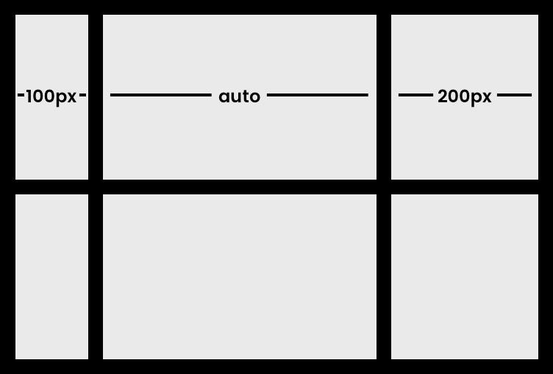
GRID Template Columns
Defines the width of the columns in the grid.
The values can be in any length unit (like px, %) or using the auto keyword.
Example: grid-template-columns: 100px auto 200px;

Slide 14
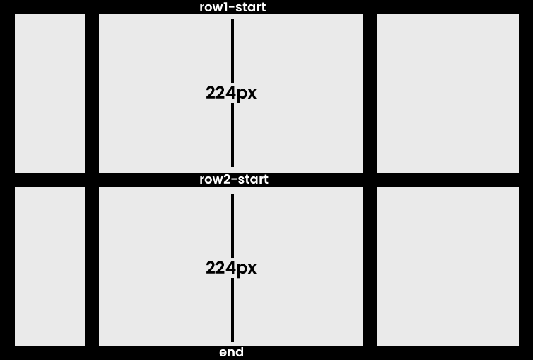
GRID Template Rows
Defines the height of the grid rows.
Example: grid-template-rows: [row1-start] 224px [row2-start] 224px [end];

Slide 15
GRID Row-Column Gap
GRID COLUMN GAP
Define the size of the grid lines between columns.
Example: grid-column-gap: 30px;
GRID ROW GAP
Defines the size of the grid lines between rows.
Example: grid-row-gap: 40px;

Slide 16
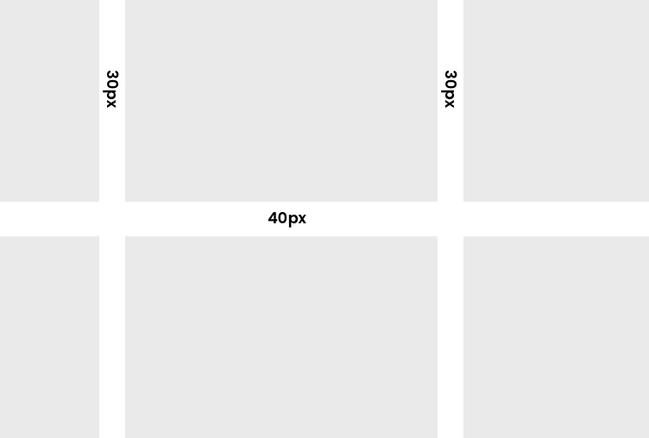
GRID Gap
Shorthand for row and column gap.
Example: grid-gap: <grid-row-gap> <grid-column-gap>; grid-gap: 40px 30px;
Note: The gap is only between columns and rows. Not outside.

Slide 17
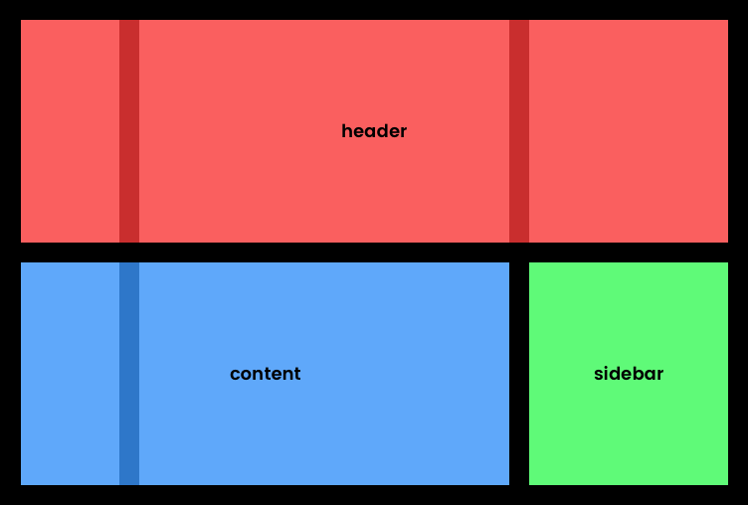
GRID Template Area
Allows you to name sections of the grid.
grid-template-columns: 100px auto 200px;
grid-template-rows: [row1-start] 224px [row2-start] 224px [end];
grid-template-areas: "header header header" "content content sidebar";

Slide 18
FRACTIONAL (FR) Units
Grid comes with the ‘fr’ unit.
It divides the available space into fractional parts and assigns them according to each track’s fr value.
It uses up a fraction of the remaining free space in the grid.
Example: grid-template-columns: 1fr 50px 1fr 1fr;

Slide 19
REPEAT() Notation
Used within properties like grid-template-columns and grid-template-rows.
To repeat a pattern of track sizes for a specified number of times.
Example: grid-template-columns: repeat(12, 1fr);

Slide 20
GRID Column Start and Column End
Determine where a grid item begins and ends along the column axis.
The values reference the grid line numbers.
Grid Column Start / Grid Column End | Grid Column
grid-column-start: 2;
grid-column-end: 4;
Shorthand
grid-column: 2 / 4;

Slide 21
GRID Row Start and End
grid-row-start and grid-row-end manage the vertical placement of grid items by referencing the grid line numbers of rows.
Grid Row Start / Grid Row End | Grid Row
grid-row-start: 1;
grid-row-end: 2;
Shorthand
grid-row: 1 / 2;

Slide 22
Quiz - 1
1. What is the purpose of the CSS Grid Layout?
A) To manage the background images of a website
B) To provide a one-dimensional layout system
C) To create complex web layouts on a two-dimensional grid-based system
2. Which CSS property is used to define a container as a grid layout?
A) display: grid;
B) display: flex;
C) grid-template-columns: auto;
3. How do you make a grid item span across two columns?
A) grid-column: span 2;
B) grid-span: 2 columns;
C) grid-columns: 2;
Notes:
Correct Answer: C) To create complex web layouts on a two-dimensional grid-based system
Correct Answer: A) display: grid;
Correct Answer: A) grid-column: span 2;

Slide 23
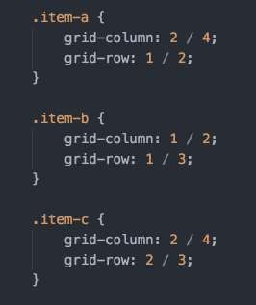
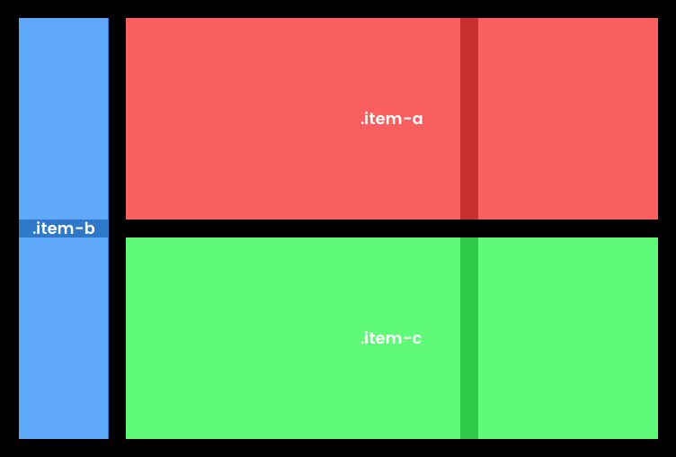
Placing Grid Items

Slide 24
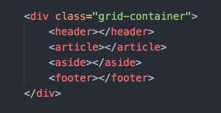
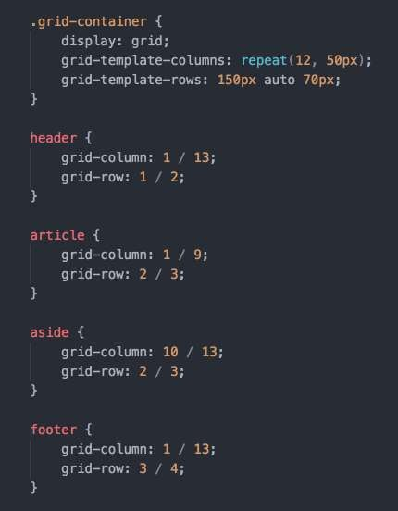
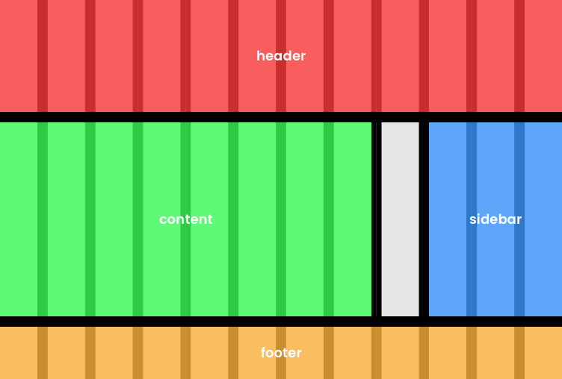
Building A Layout

Slide 25
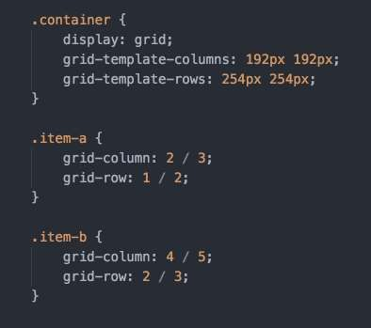
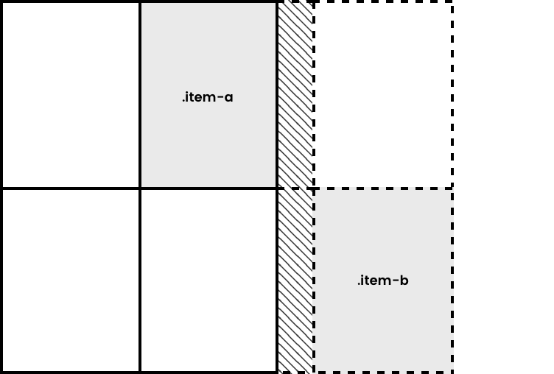
GRID Auto Rows & Columns
Set row or column sizes for those not explicitly set.

Slide 26
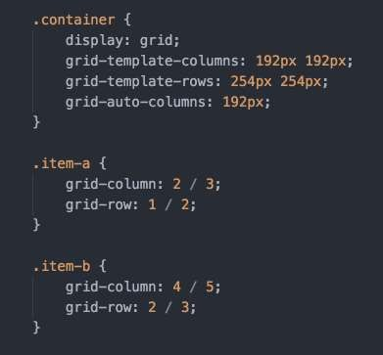
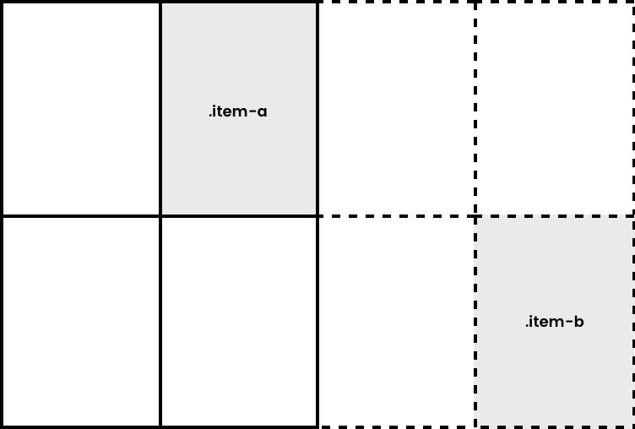
GRID Auto Rows & Columns
Set row or column sizes for those not explicitly set.

Slide 27
CSS flexbox layout

Slide 28
Flexbox Layout
Flexible Box Layout Module - Flexbox
Popular CSS Layout Module
Offers greater control over arranging components of web page items along one axis (Ex: menu bars, product listings, galleries)
Advantages of Flexbox
Ability to “flex” – stretch or shrink inside their containers
Ability to make all neighboring items the same height
Easy horizontal and vertical centering
Ability to change the display order of items independent of the html source

Slide 29
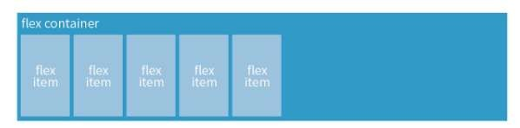
CSS Layout - Flexbox
Flexbox Container
Create a flex container by setting the element’s display property to flex or inline-flex.
.flex-container {
display: flex;
}
.flex-container {
display: inline-flex;
}
/* or */
Display: flex creates a block-level flex container
Display: inline-flex creates an inline-level flex container

Slide 30
CSS Layout - Flexbox
Flex container - Flex items
Applying the flex display mode turns the child elements of the flex container into flex items
Any flex item can be turned into a flex container by setting its display to flex (resulting in nested flexbox)

Slide 31
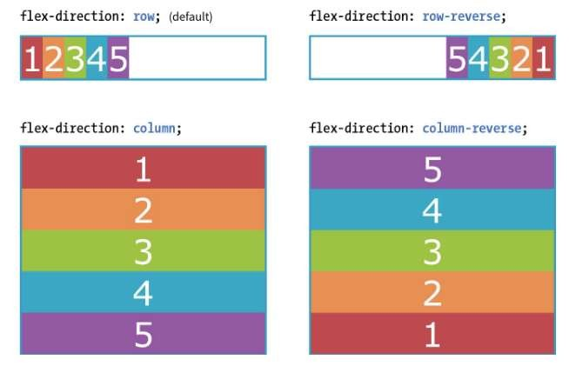
CSS Layout - Flexbox
Flex container - Properties
Flex container properties allow you to control how items appear within the container.
flex-direction
row | column | row-reverse | column-reverse

Slide 32
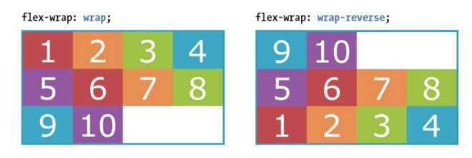
CSS Layout - Flexbox
flex-wrap
nowrap | wrap | wrap-reverse
Figure 16-5. Niederst, J. (2018). Learning Web Design. O'Reilly Media, Inc.
THE MARKUP
<div id=“container”>
<div class=“box box1”> 1</div>
<!– more boxes here
<div class=“box box10”> 10 </div>
</div>
THE STYLES
#container {
display: flex;
flex-direction: row; flex-wrap: wrap;
}
.box {
width: 25%;
}

Slide 33
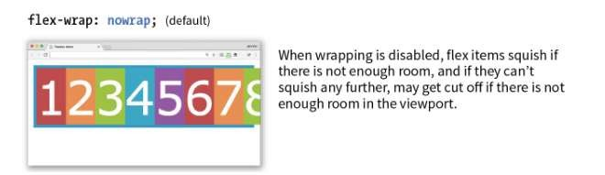
CSS Layout - Flexbox
flex-wrap
nowrap | wrap | wrap-reverse
Figure 16-5. Niederst, J. (2018). Learning Web Design. O'Reilly Media, Inc.

Slide 34
CSS Layout - Flexbox
flex-flow (shorthand)
flex-direction flex-wrap
Using flex-direction & flex-wrap #container {
display: flex; height: 350px;
Using flex-flow
#container { display: flex;
height: 350px;
flex-flow: column wrap;
}
flex-direction: column;
flex-wrap: wrap;
}

Slide 35
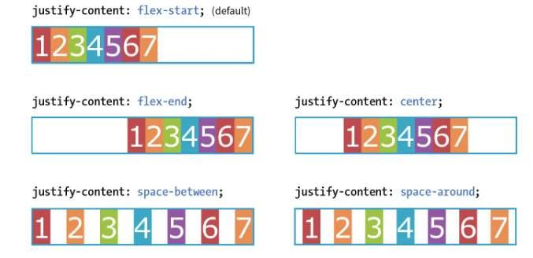
CSS Layout - Flexbox
Flexbox Alignment Properties
justify-content
flex-start | flex-end | center | space-between | space-around
Flex items are, by default, as wide as they need to be to contain the element’s content.
The justify- content property defines how extra space is distributed around or between items.

Slide 36
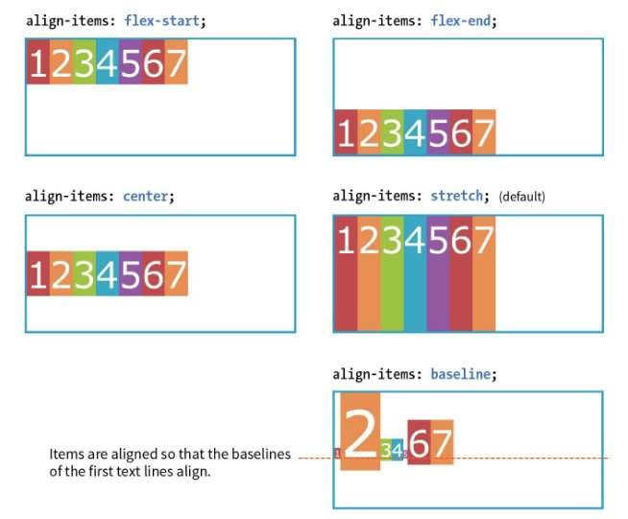
CSS Layout - Flexbox
Flexbox Alignment Properties
align-items
flex-start | flex-end | center | baseline | stretch
The align-items property allows to arrange items on the cross axis (up and down when the direction is row, left and right if the direction is column)
Container height must be specified.

Slide 37
CSS Layout - Flexbox
Flex item - Properties
flex item properties determines how space is distributed within items.
flex
None | ‘flex-grow
flex-shrink
flex-basis’
Flex: flex-grow flex-shrink flex-basis
Example li {
flex: 1 0 200px
}
This list item starts at 200px wide and is allowed to grow to fill extra space and is NOT allowed to shrink below 200px
Values of 1 and 0 work as on/off switch
1 “turns on” or allows an item to grow or shrink
0 “turns off” prevents item from growing or shrinking

Slide 38
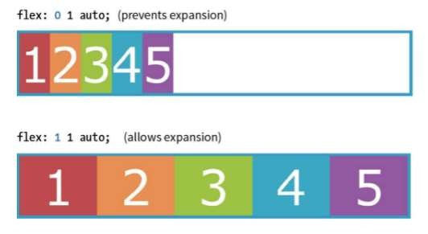
CSS Layout - Flexbox
Flex item - Properties
flex-grow
Value: number Default: 0
THE MARKUP
<div id=“container”>
<div class=“box box1”> 1</div>
<div class=“box box2”> 2</div>
<div class=“box box3”> 3</div>
<div class=“box box4”> 4</div>
<div class=“box box5”> 5 </div>
</div>
THE STYLES
.box {
…
flex: 1 1 auto;
}

Slide 39
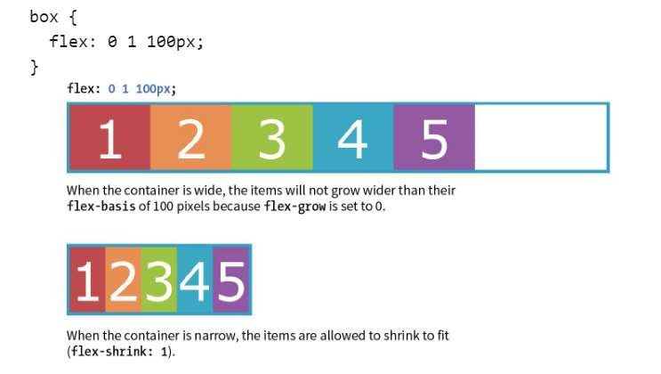
CSS Layout - Flexbox
Flex item - Properties
flex-shrink
Value: number Default: 1
When flex-shrink is 0, items are not permitted to shrink and may hang out of their containing element.
Flex items stop shrinking when they reach their minimum size (defined by min-width/min-height).

Slide 40
CSS Layout - Flexbox
Flex item - Properties
flex-basis
Value: length | percentage | content | auto
Flex-basis defines the starting size of an item before any wrapping, growing or shrinking occurs. It may be used instead of the width property (or height for columns) for flex items.
By default, flex-basis is set to auto (width/height value of item size)
If item’s size is not defined or set to auto – flex- basis uses the content width.

Slide 41
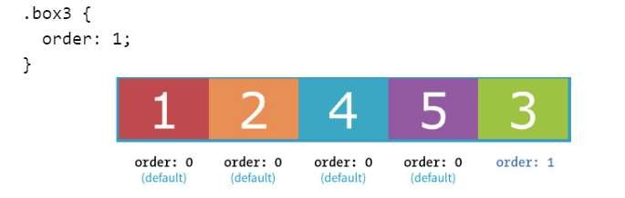
CSS Layout - Flexbox
Flex item - Properties
order
Value: integer
The order property give the ability to display items in an order that is different from the order in the HTML source code.
If items have the same order value = laid out in order they appear in code
If items have different order values = arranged from the lowest order value to highest.

Slide 42
Quiz - 2
1. What is the main idea behind the Flexbox layout?
A) To provide a method for arranging items in a grid
B) To offer a one-dimensional layout model for laying out items in rows or columns
C) To control the background properties of a container
2. Which CSS property defines a flex container?
A) display: flex;
B) flex-direction: row;
C) flex-wrap: wrap;
3. How can you align items in the center of a flex container along the cross axis?
A) justify-content: center;
B) align-items: center;
C) flex-align: center;
Notes:
Correct Answer: B) To offer a one-dimensional layout model for laying out items in rows or columns
Correct Answer: A) display: flex;
Correct Answer: B) align-items: center;

Slide 43
References
CSSGrid.io - Wes Bos
A Complete Guide to Grid - CSS Tricks
Get Ready for CSS Grid Layout - A Book Apart
11 Things I Learned Reading The CSS Grid Specification - Ohans Emmanuel
How to recreate Medium’s article layout with CSS Grid - Per Harald Borgen
CSS Grid Spec - W3C
Firefox Developer Edition
https://css-tricks.com/snippets/css/a-guide-to-flexbox/
https://css-tricks.com/things-ive-learned-css-grid-layout/

Slide 44
Topic 5 – CSS Flexbox and Grid Layout
Any Questions?
Notes:
NCC Education - End Slide Master

